Slide 1
My Dream PC
By Alexie Roy

Slide 2
What I would want my Computer to do?
I would want my computer to…
Have a great amount of storage for school work, media applications (i.e. Netflix), remote online work, video chat, and/or gaming
Have more speed for doing research, uploading files, downloading games, etc.
Be versatile
Have accuracy
Be able to have good memory

Slide 3
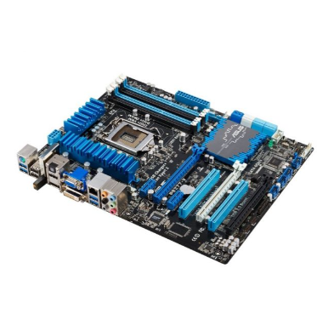
Component 1: Motherboard
Motherboard: it’s the computer’s central communications connectivity point among hardware components and ports.
The purpose of the Motherboard for my PC is...
To determine what the processor in my computer will be able to use.
It determines the features I have, or can add to my PC.
To allow the communication between certain hardware components and the CPU and RAM.
I chose this motherboard because it’s eco-friendly and allows my PC to have certain features such as overclocking and SLI.
Price: $236.81
Source: DX38BT - Intel X38 LGA-775 ATX Extreme Series Desktop Motherboard (harddiskdirect.com)

Slide 4
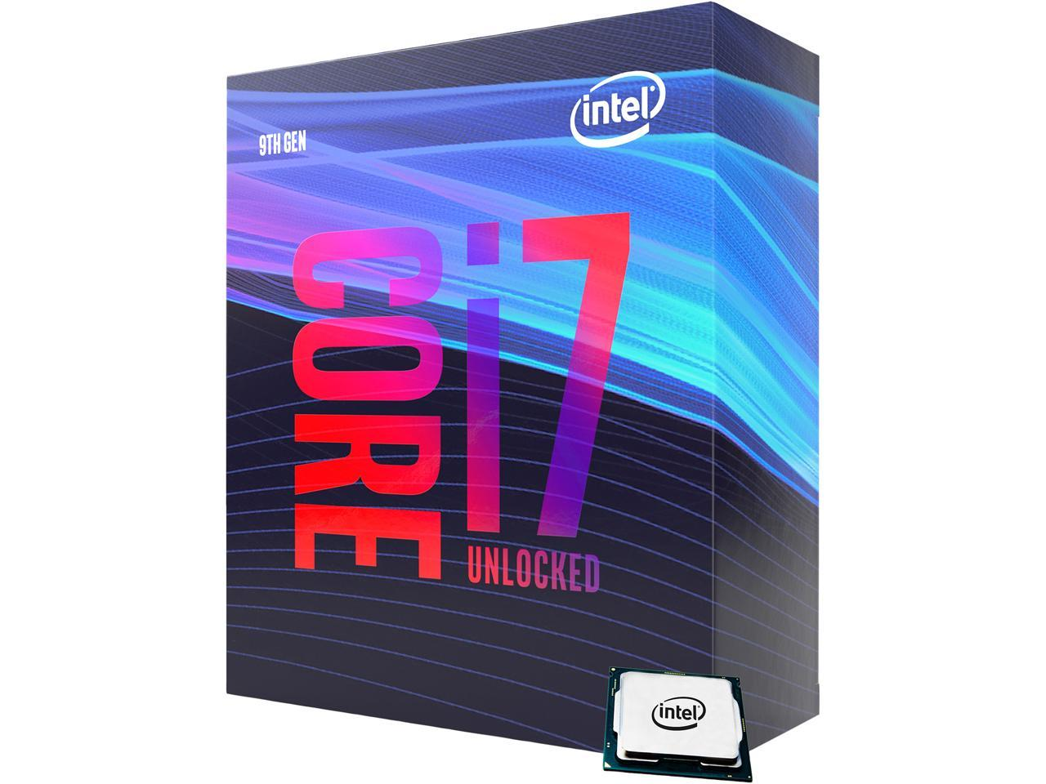
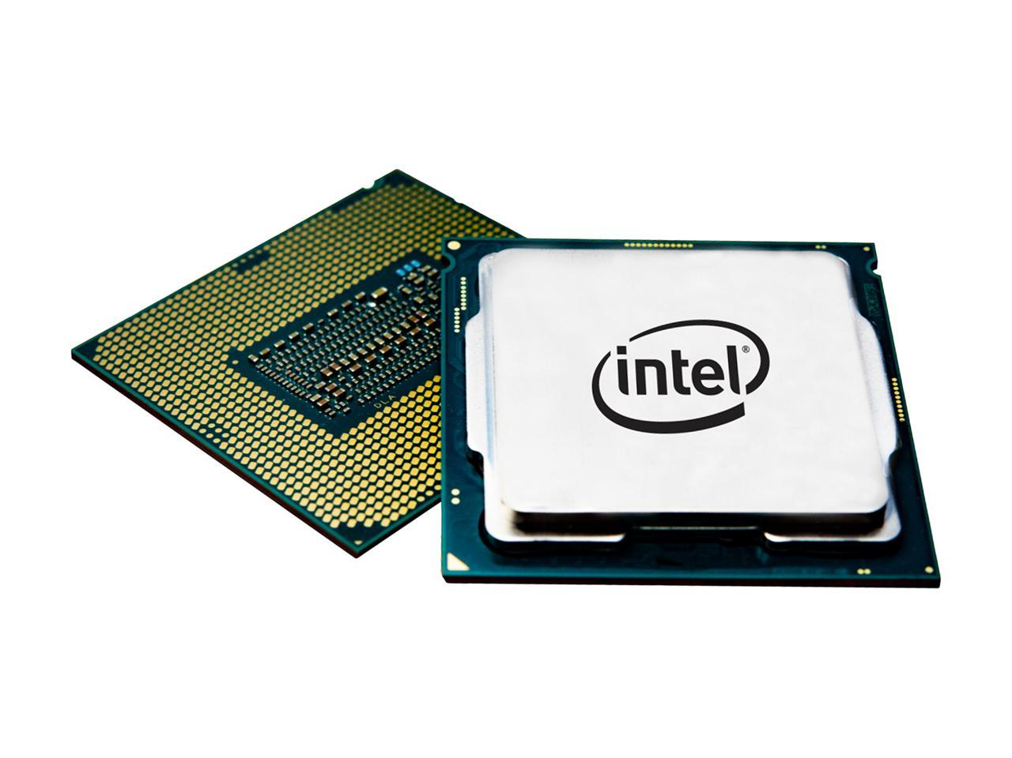
Components 2: CPU
The CPU (or Processor) known as the “main brain” of the computer.
The purpose of the CPU is to focus on the performance of the computer system.
I chose this CPU because it processes certain instructions and tell certain parts of the computer to do specific tasks which includes processing gaming instructions, have data searched on the Internet, calculate with the ALU, move data from one memory location to another.
Description: it’s compatible with Intel 300 Series Motherboard, has socket LGA 1151 (300 Series), has max Turbo Frequency 4.9 GHz, has DDR4 Support, the Intel Optane Memory and SSD Supported, & the Intel Turbo Boost Technology 2.0 and Intel vPro technology offer high performance for enthusiast gaming, creating, and overclocking
Price: $269.00
Source: Intel Core i7-9700K Coffee Lake 8-Core 3.6 GHz CPU Processor - Newegg.com

Slide 5
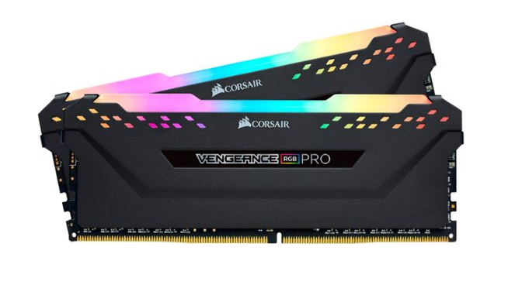
Component 3: RAM (Random Access Memory)
RAM: a computer memory (a byte of a memory) that can be accessed randomly.
The purpose of having RAM for my PC is to make sure that my PC runs smoothly and make sures that my PC has enough memory.
I chose this RAM for my PC because of its multitasking capability and of the anodized aluminum heat-spreader that keeps memory cool for efficient operation.
Description: Has a kit of 2 8GB DDR4 SDRAM memory modules, 288-pin DIMM for a capable system operation in which DIMM is dual in-line memory module, it has up to 3000 MHz operating speed which gives great multitasking capability, and a anodized aluminum heat-spreader that keeps memory cool for efficient operation.
Price: $81.99
Source: CORSAIR Vengeance RGB PRO 16GB (2PK 8GB) 3GHz PC4-24000 DDR4 DIMM Unbuffered Non-ECC Desktop Memory Kit with RGB Lighting Black CMW16GX4M2C3000C15 - Best Buy

Slide 6
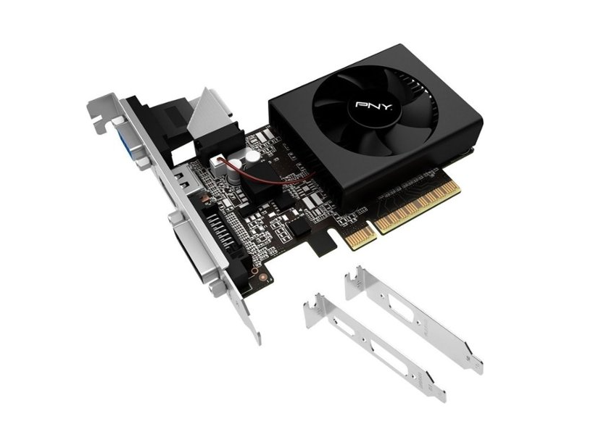
Component 4: GPU
GPU: it provides the fastest graphics processing.
The purpose of having GPU for my PC is to have a boost in gaming performance and graphics.
I chose this GPU for my PC because of it being inexpensive and it enhances gaming physics.
Description: It is powered by the NVIDIA GeForce GT 710 graphics processing unit (GPU), has a 954MHz clock speed to help meet the needs of demanding games, has 2GB on-board memory, 192 CUDA processing cores and up to 12.8GB/sec. of memory bandwidth provide the memory, has PCI Express 2.0 x8 interface which offers compatibility with a range of systems, has VIDIA PhysX technology to enhance gaming physics, has NVIDIA CUDA technology to harness power of the graphics processing unit (GPU) to optimize computing performance, disables VSync when frame rates fall below the locked rate, and re-enables it when they return to the locked rate, to significantly reduce stutter and prevent screen tearing.
Price: $49.99
Source: PNY NVIDIA GeForce GT 710 VERTO 2GB DDR3 PCI Express 2.0 Graphics Card Black VCGGT7102XPB-BB - Best Buy

Slide 7
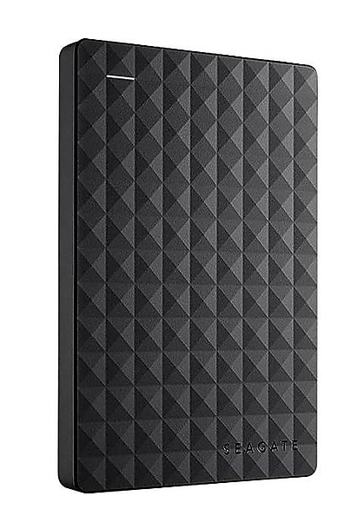
Component 5: Storage Device- Seagate Expansion 1TB USB 3.0 External Hard Drive
Storage Device: an equipment that store data and information onto computer
The purpose of having this storage device is because to store data and software that I have onto my computer.
I chose this storage device Seagate Expansion 1TB USB 3.0 External Hard Drive because it’s inexpensive and powers up via USB to eliminate need for additional power supply.
Description: must be plugged in, has portable drive in black features 1TB storage capacity and PC compatibility, uses USB 3.0 for ultra-fast data transfer and works with USB 2.0 ports on older machines, powers up via USB, and has 1-year manufacturer limited warranty.
Price: $59.99
Source: Seagate Expansion 1TB USB 3.0 External Hard Drive, Black (STEA1000400) at Staples

Slide 8
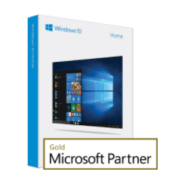
Component 6: Operating System
Operating System: the software that supports a computer's functions
Purpose: It’s to unify experience on the computer and work with programs.
The operating system for my dream PC is Windows 10 because it gives this leeway in the configuration of the applications and other components, making any updates flexible.
Description: you are allowed to customize the new Start menu with your favorite apps and games, are able to stay productive with enhancements to Snap, new Task View, and Multiple desktops, and cortana works across your day and your devices
Price: $103.95
Source: Microsoft Windows 10 Home (64-Bit) License – Trusted Tech Team

Slide 9
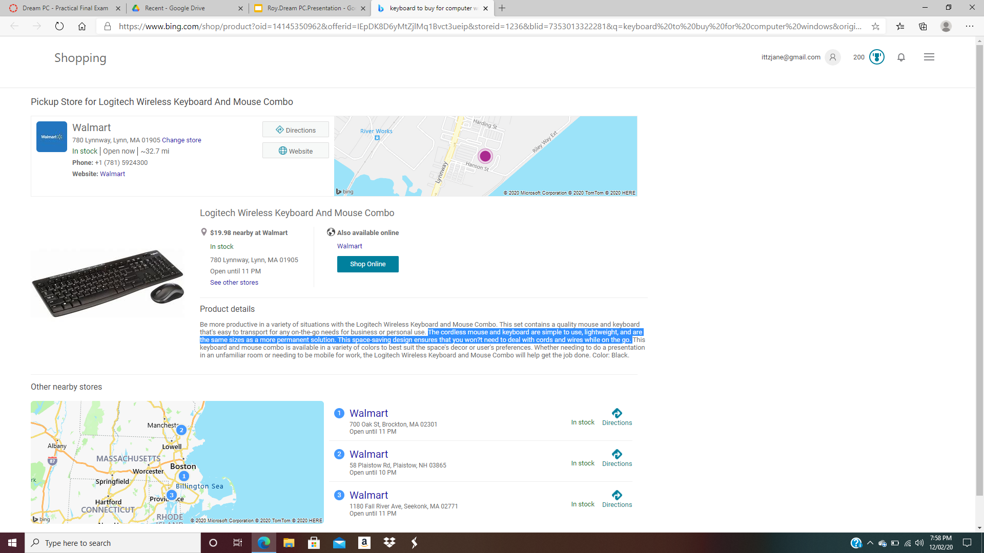
Component 7: Keyboard
Keyboard: allows a person to type a document, certain commands, play games, and access menus.
The purpose of the keyboard is to act as an input device.
I chose this keyboard for my PC because of its price and the keyboard is wireless, which i can take on the go.
Description: The cordless mouse and keyboard are simple to use, lightweight, and are the same sizes as a more permanent solution, and let’s you save space without dealing with a lot of cords and wires.
Price: $19.98
Source: keyboard to buy for computer windows - Bing - Shopping

Slide 10
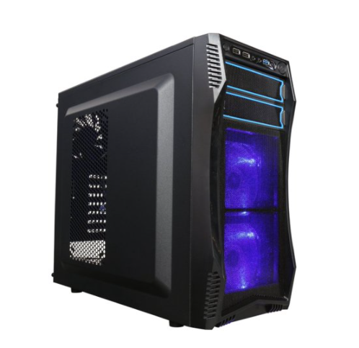
Component 8: Computer Case
Computer Case: the enclosure that contains most of the components of a PC.
The purpose of the computer case for my PC is to enclose and protect the hardware components that are inside.
I chose this computer case because it is inexpensive and it’s quipped with dust filters on both top and bottom
Description: it has tool-free installation of 5.25" devices and 3.5" HDD ensures a hassle-free experience.
CAPACITY, and it Supports up to 14.17" (360mm) long graphics card plus a 120mm liquid-cooling radiator in the front, Micro ATX /ATX /Mini-ITX Motherboard Compatibility, it supports up to 13.3" (360mm) Video Cards, has 3 Fans Pre-installed, & supports up to 5 Fans.
Price: $54.99
Source: Rosewill CHALLENGER S Black Gaming ATX Mid Tower Computer Case w/ Blue LED Fans - Walmart.com - Walmart.com

Slide 11
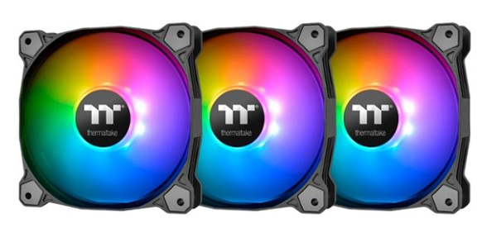
Component 9: Cooling Fans
Cooling Fans: it’s to move heated air away from the components while drawing cooler air over them.
The purpose of the cooling fans for my PC is to cool the components and prevent those components from overheating.
I chose this cooling fan because of it ensuring a quiet operation when cooling the components.
Description: Compatible with most cases, has 120mm cooling fan to transfer heat from components, has hydraulic bearing design to ensure long-lasting operation, has 56.45 cfm airflow volume to ensure efficient cooling, has 25.8dBA noise level to ensure quiet operation, has 500-1500 rpm operating speed for faster cooling, and LED illumination
Price: $64.99
Source: Thermaltake Pure Plus 12 LED RGB (Triple Pack) Radiator Fan TT Premium Edition 120mm Case Cooling Fan Kit with RGB Lighting Black CL-F063-PL12SW-A - Best Buy

Slide 12
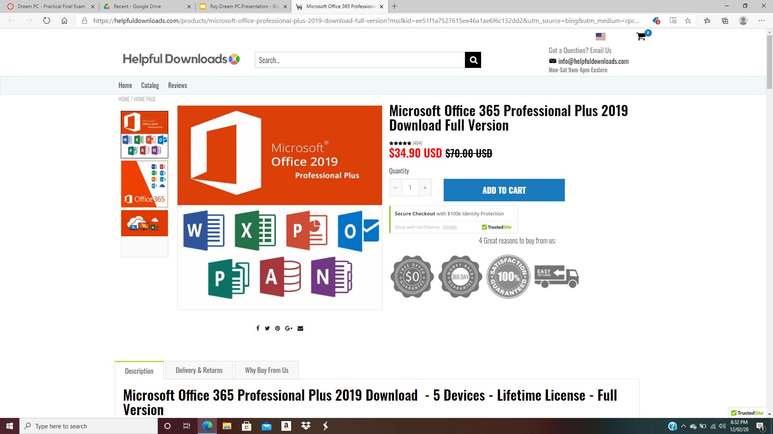
Component 10: Software Application- Microsoft Applications
Software Applications: the programs made to run on one or more systems.
Purpose: It’s to manage information, manipulate data, construct any graphics or visuals, coordinate resources, and calculate certain things.
I chose the Microsoft Office 365 Professional Plus 2019 Download Full Version in order to use all the Microsoft applications for school projects, essays, and anything related to technical work (i.e. create databases).
Description: it’s bases on the latest versions of Word, Excel, PowerPoint, Outlook, OneNote, Publisher, Access, and certain Office Web Apps and Skype which is used to enhance productivity and communication.
Price: $34.90
Source: Microsoft Office 365 Professional Plus 2019 Download Full Version – Helpful Downloads

